Slide 2
Placements potentially on offer through the Crick’s T-level programme
Autumn 2025

Slide 3
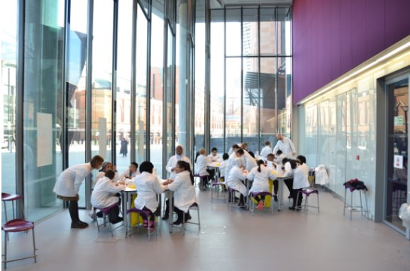
The Education Team
About our team...
The Crick's Education Outreach team are passionate about bringing science to life for young people in Camden. We run a range of interactive and inclusive activities for children aged between 5-18, either in their schools or in the Crick's Weston Discovery Lab – our dedicated on-site laboratory for students. Find out more here.
Education Outreach
During this placement, the student(s) will work with the Education Team's Lab Manager to…
Support in setting up for workshops in our on-site laboratory, including preparing chemicals
Support in resourcing the workshops, ordering materials and tracking finances against budget
Support in organizing the lab, including adhering to Health & Safety protocols and writing Risk Assessments
The ideal student will be interested in…
Learning how a laboratory operates and is managed
Learning more about health and safety in the lab
Gaining experience in organization, admin and financial management
Working with people, including children!

