Slide 1
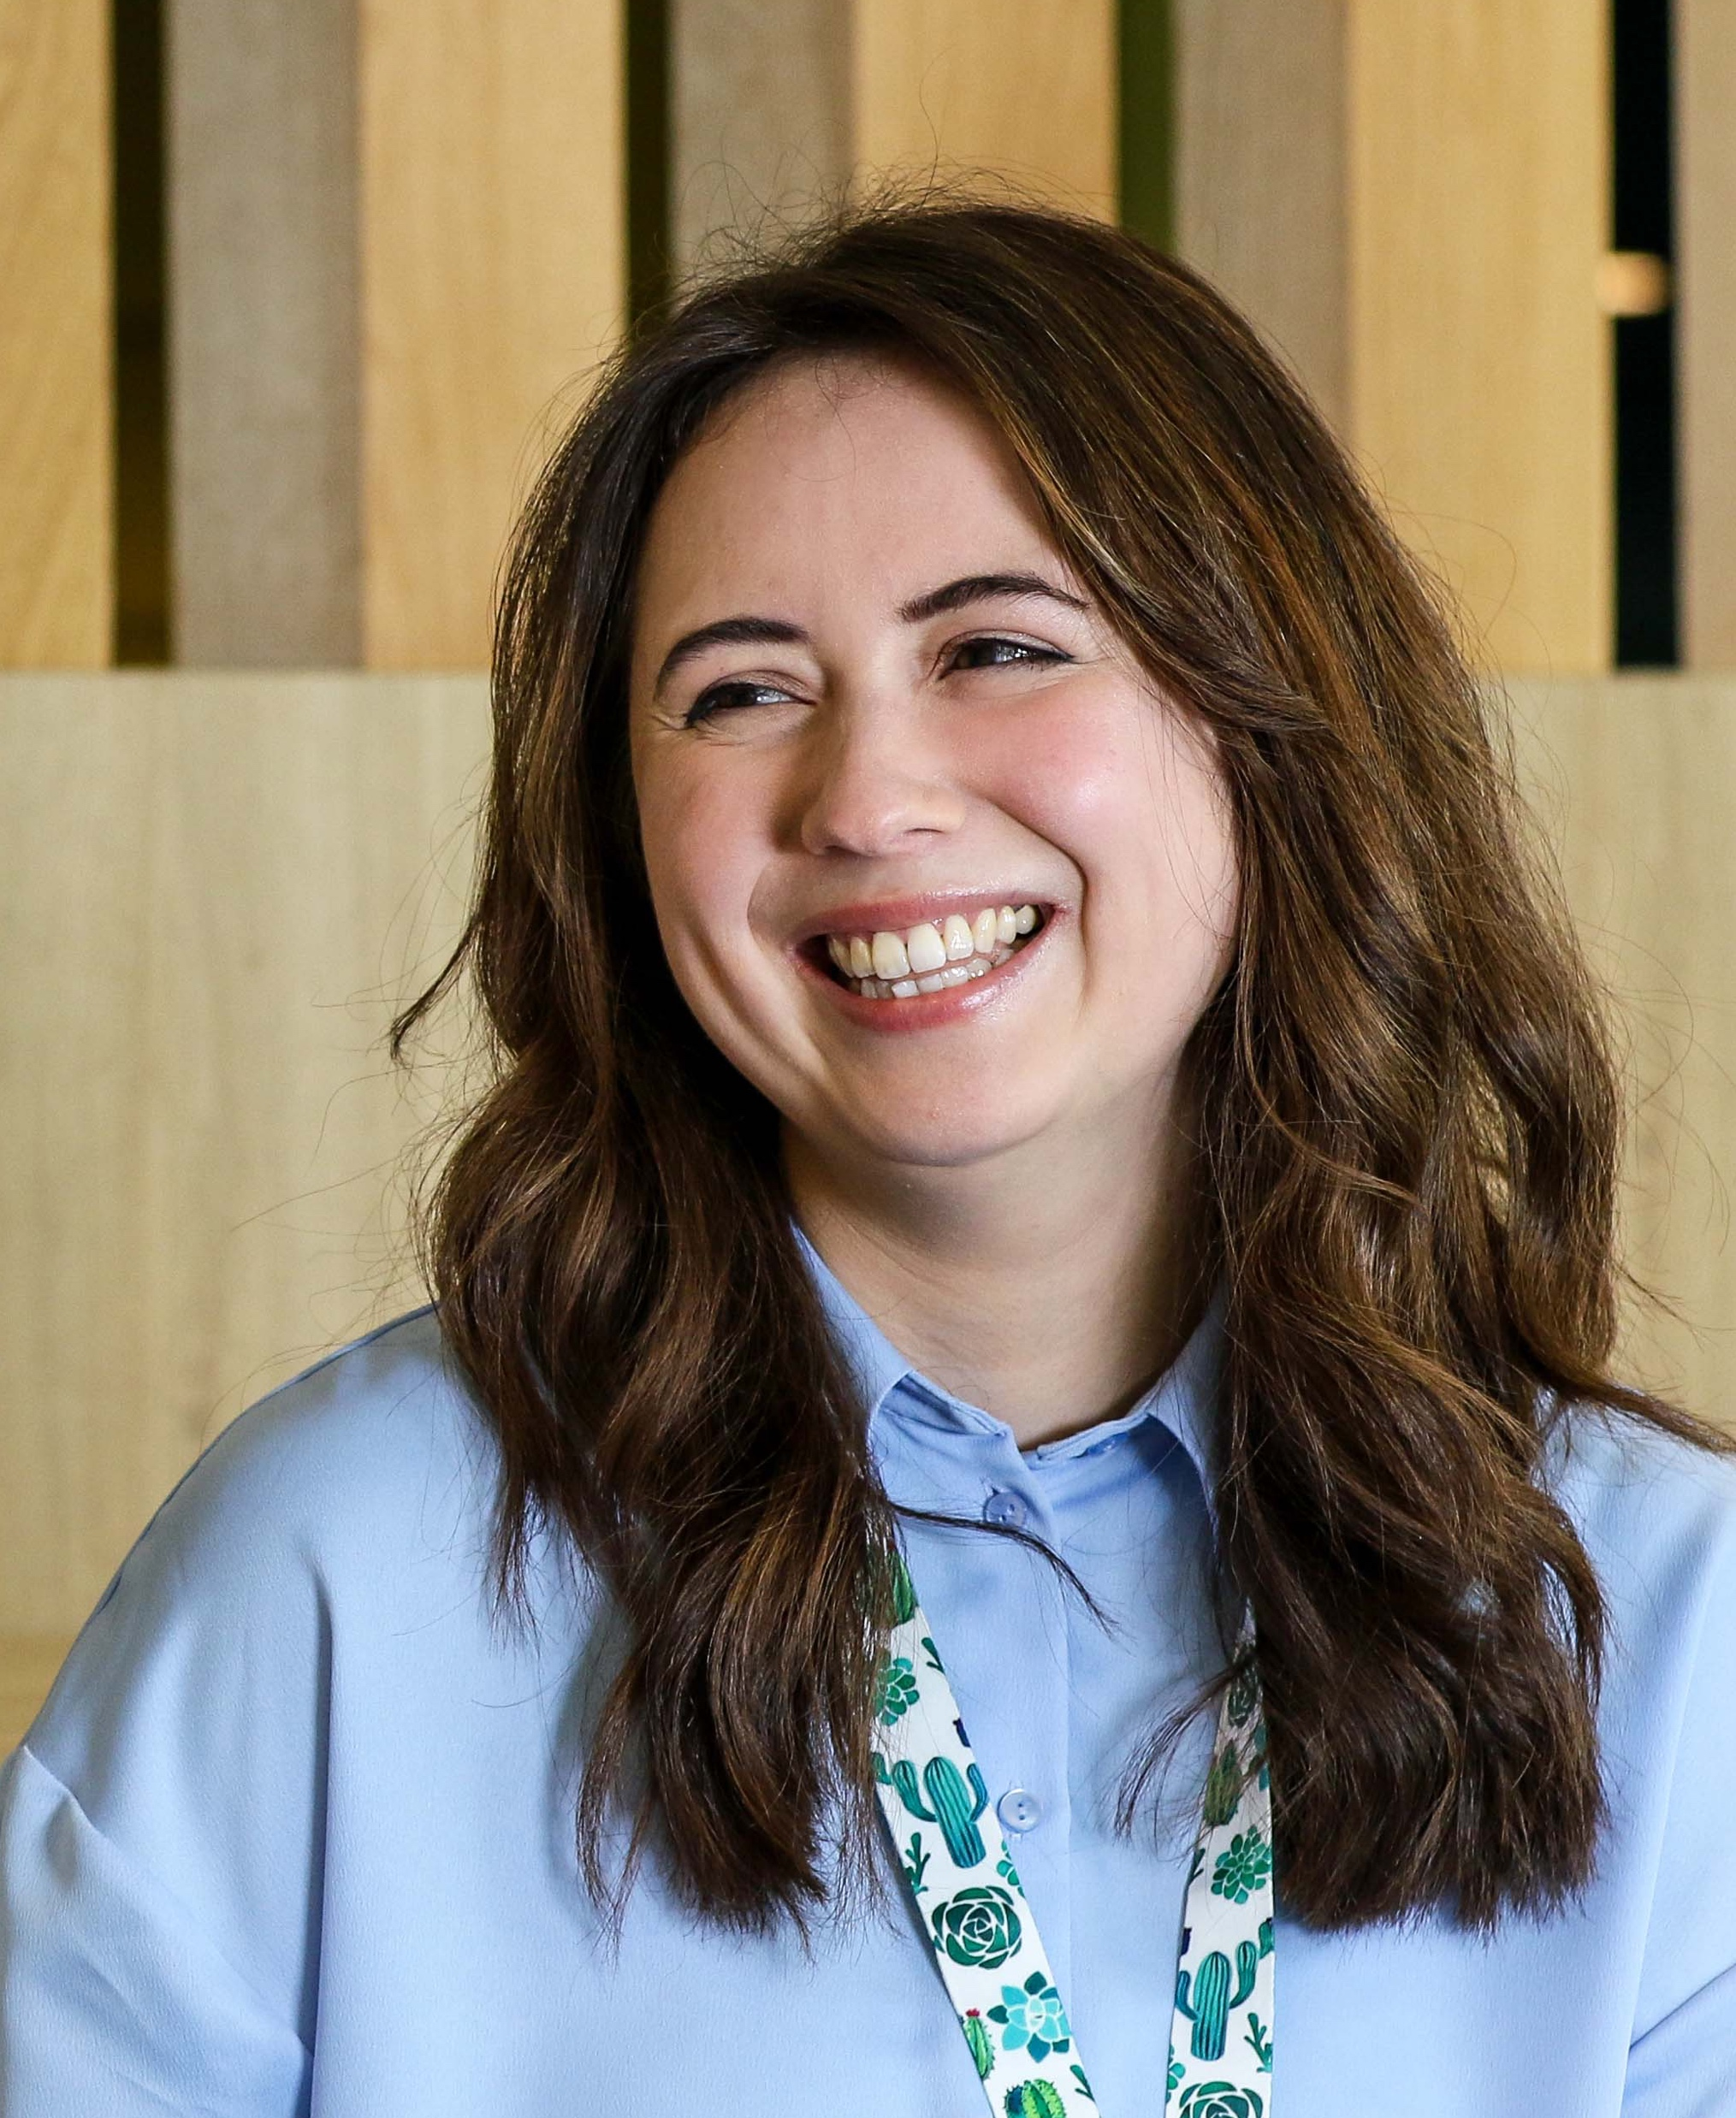
Line Manager Guide to T Levels
Digital Talent Team
Your Digital Group T Level point of contacts are:​
Rachel.Nulty@DWP.gov.uk​
Emma.Price@DWP.gov.uk
Digital
With
Purpose

Slide 2
01
What are T Levels?
04
Onboarding actions
02
The role of the Line Manager
05
How to's
03
Pre-boarding actions
06
Checklist

Slide 3
What are T Levels?
Equivalent to A Levels, T levels take 2 years to complete.
Students are usually 16-19 years old
They blend learning with work placements.
Placements will be either admin or digital to apply the academic learning
Work placements are of 45 days undertaken in a block, several blocks or as day release
Students are issued with equipment and treated as an employee for the placement but as they are full time student, placements are unpaid

Slide 4
Digital T Levels
This course is suitable for anyone wanting a career in software production and design. Students will develop an understanding of a broad range of issues relevant to the sector, including:
how digital technologies impact business
the ethical and moral implications of digital technology
using data in software design
using digital technologies to analyse and solve problems
digital environments, including physical, virtual and cloud environments
emerging technical trends
They will develop the skills to:
analyse a problem, understand user needs, define requirements and set acceptance criteria
design, implement and test software
change, maintain and support software
work collaboratively in a digital team
discover, evaluate and apply reliable sources of knowledge
work within legal and regulatory frameworks when developing software
Business Admin T Levels
This course is suitable for anyone wanting a career in IT, specifically in areas such as IT solutions or data analysis. Students will develop an understanding of a broad range of issues relevant to the sector, including:
how digital technologies impact business and market environment
the ethical and moral implications of digital technology
using data in software design
using digital technologies to analyse and solve problems
digital environments, including physical, virtual and cloud environments
legal and regulatory obligations relating to digital technologies
They will also develop the knowledge and skills of a data technician:
sourcing, organising and formatting data for analysis
blending data from multiple sources
analysing data to support business outcomes
interpreting data and communicating the results
discovering, evaluation in applying sources of knowledge

Slide 5
The role of the Line Manager
Provide guidance
Provide advice, guidance, support and encouragement at the appropriate level for their experience
Don’t do it for them – guidance with appropriate level of direction
Give feedback
Take the time to provide honest, useful, actionable feedback
Not just constructive and corrective feedback, but also praise and reinforcing
Encourage others to provide feedback too
Remember that this is likely to be the first role in a professional environment so they may need some support to understand the expectations
Planning Work
A minimum of 80% of the placement should be completed in the Hub, if you cannot accommodate that in your team please contact Rachel Nulty
Understand the requirements of the T Level so you can help the student to achieve evidence of performance
Find opportunities for the student to experience the range of work undertaken in your team whilst respecting confidentiality
Provide meaningful work that helps the student to develop and your team deliver

Slide 6
The role of a line manager
The role of the Line Manager
Monitoring Progress
Meet regularly to review progress (work, expectations of the T Level)
Meet regularly with the T Level Student to mentor their learning
Pay attention to gaps or areas of difficulty
Give feedback to the School/ College about performance during the placement including at the mid placement meeting with the teacher and student
Support for Line Managers
Read information provided by the school or college
Peer support from other line managers
Support from your practice team
Support from the Digital Talent Team
SharePoint and intranet pages
Enjoy It!
Managing an T Level student can be a rewarding experience and will help to develop both yourself and the student
Opportunity to network and gain recognition

Slide 7
Pre-boarding actions
As Line Manager, your role in a successful induction journey is crucial. The induction will set the tone for the placement and is as important for T Level students as it is for all permanent members of the team.
3 – 4 weeks pre-placement
2 - 3 weeks pre-placement
Arrange a call with the student and their teacher to discuss the placement, expectations, working pattern and agree a start date
Request a pseudo staff number (see the how to section) there is a 5 day SLA to receive the staff number
Assign a buddy for the duration of the placement. The student is likely to have questions and an additional friendly contact will help
Brief your team, let them know what a T level is, when the student will be joining you, what they should expect of the student and what you expect of them

Slide 8
Pre-boarding actions
As Line Manager, your role in a successful induction journey is crucial. The induction will set the tone for the placement and is as important for T Level students as it is for all permanent members of the team.
2 - 3 weeks pre-placement
1 - 2 weeks pre-placement
Call the student to discuss arrangements for the first day including where they will meet you and at what time, dress code, lunch arrangements etc.
Complete a Young Persons Risk Assessment on TARAHS, please do this at least 1 week prior to their start date in case any issues need to be addressed​​
Finalise the content of the placement

Slide 9
Onboarding actions
Meet the student in person on their first day and welcome them to Digital.
Make time to discuss your expectations and theirs. Confirm the working pattern.
Their ID will need to be verified.
Introduce the student to your team.
Explain the normal working patterns and routines of the team, when you meet and how you communicate
​
The student will need to complete their Essential Learning and you will need to complete the Line Manager Declaration of Completion of Essential Learning.
Introduce the student to their buddy and explain the role of the buddy and how they will support them during the placement.
Arrange a building tour
Check with the student if the college are paying their travel expenses, if not we can reimburse this through SOP

Slide 10
How to get a pseudo staff number
Open the form RMG63​
You can also find the form through DWP myHub under Find a Form​
Complete the form with the student and line manager details​
Once completed send to SSCL via a service request on SOP (Use Service Request ‘Joining’ and type NEW Entrant)​
SSCL have a 5 day SLA to provide the staff number (a tip to get it in time to order equipment for a start is put an earlier start date in)​
Please note - if the Line Manager for the student is someone who does not work for DWP, such as a contractor and does not have access to SOP, someone else can complete the Service request for them and stipulating in the notes that you are completing on behalf of … due to no SOP access
This can be done for all sites through the Digital Spaces Wizard - Digital Spaces Wizard​
How to order a building pass

Slide 11
Completion and next steps
Apprenticeship vacancy
Associate in a profession
Working level in a profession
Senior in a profession
Lead in a profession
Head of Role
EO
HEO
SEO
G7
G6
G6
Upon completion of the T Level placement, the student will return to college or school and complete their T Level qualification.
There is no automatic role for T level students at the end of their placement.
T Level students may wish to continue their education or look for employment on completion of their qualification.
Apprenticeships could be an ideal next step for T Level students on completion of their qualification. Talk to your student about the apprenticeships in Digital and where that could lead to.
Talk to your students about career progression, what opportunities might be coming up within your team, and what they want to gain from their next roles. They may need support and advice about the application process.
It’s best not to leave these conversations until they have completed their placement.

Slide 12
Checklist
To Do | Completed
Meet with student and teacher to agree role and start date
Young Person risk assessment
Order pseudo staff number
Order building pass
Assign buddy
Agree touchpoints with teacher for check in calls
Planned the work and the support that will be needed for the duration of the placement

Slide 13
Questions and Contact Details
Your Digital Group T Level point of contacts are:​
Rachel.Nulty@DWP.gov.uk ​
Emma.Price@DWP.gov.uk

